Slide 1
Computer Communication Network -Performance
Dr. Geetha. V
Asst Professor
Dept of IT
NITK Surathkal

Slide 2
Index
Performance
Bandwidth
Latency
Excercise

Slide 3
Performance -Bandwidth
Bandwidth: (Throughput) of a network is given by the number of bits that can be transmitted over the network in a certain period of time.
Bandwidth in Hertz
Bandwidth in Bits per Second

Slide 4
Performance - Bandwith
Bandwidth in Hertz
Bandwidth in Hertz is the range of frequencies contained in a composite signal or the range of frequencies a channel can pass.
If the telephone network bandwidth ranges from 300Hz to 3300 Hz, then bandwidth = 3300-300=3000 Hz

Slide 5
Performance - Bandwith
Bandwidth in Bits per second
Bandwidth can also refer to the number of bits per second that a channel, a link, or even a network can transmit.
Eg. Ethernet Bandwidth 10Mbps.

Slide 6
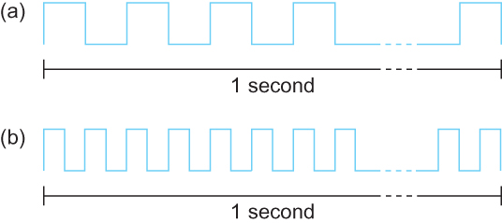
Performance – Bit length
Each bit on a 1 Mbps line is 1 µs wide. (1/10^6)
Each bit on a 2 Mbps line is 0.5 µs wide. (1/(2 x 10^6))

Slide 7

Performance - Latency
Latency: How long it takes a message to travel from one end of network to other.
1Km Bridge
1Km Train
What is the time taken to completely cross the bridge
if the train taken 5minutes to travel 1Km.

Slide 8
Performance - Latency
Latency: How long it takes a message to travel from one end of network to other.
End of 5 Min

Slide 9
Performance - Latency
Latency: How long it takes a message to travel from one end of network to other.
End of 10 Min

Slide 10
Performance - Latency
Latency: How long it takes a message to travel from one end of network to other.
Latency = Propagation + Transmit + Queue
Propagation=Distance/Speed of Light
Transmit = Size/Bandwidth
Round Trip Time = 2 x Latency
Speed of Light:
3.0 x 10⁸m/s in vacuum,
2.3 x 10⁸ m/s in copper cable ,
2.0 x10⁸ m/s in optical fiber

Slide 11
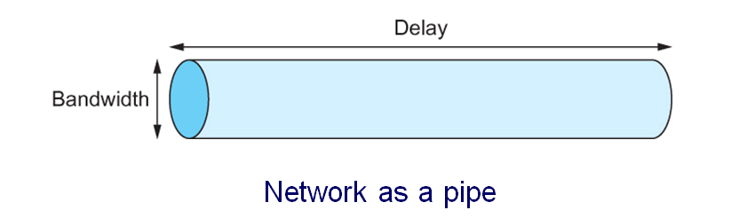
Performance
Delay x Bandwidth Product:
We think the channel between a pair of processes as a hollow pipe
Latency (delay) length of the pipe and bandwidth the width of the pipe
Delay of 50 ms and bandwidth of 45 Mbps
50 x 10⁻³ seconds x 45 x 10⁶ bits/second = 2.25 x 10⁶ bits

Slide 12
Performance
Relative importance of bandwidth and latency depends on application
For large file transfer, bandwidth is critical
For small messages (HTTP, NFS, etc.), latency is critical
Variance in latency (jitter) can also affect some applications (e.g., audio/video conferencing)

Slide 13
Performance
Delay X Bandwidth Product helps to analyse
How many bits the sender must transmit before the first bit arrives at the receiver if the sender keeps the pipe full
Takes another one-way latency to receive a response from the receiver
If the sender does not fill the pipe—send a whole delay × bandwidth product’s worth of data before it stops to wait for a signal—the sender will not fully utilize the network

Slide 14
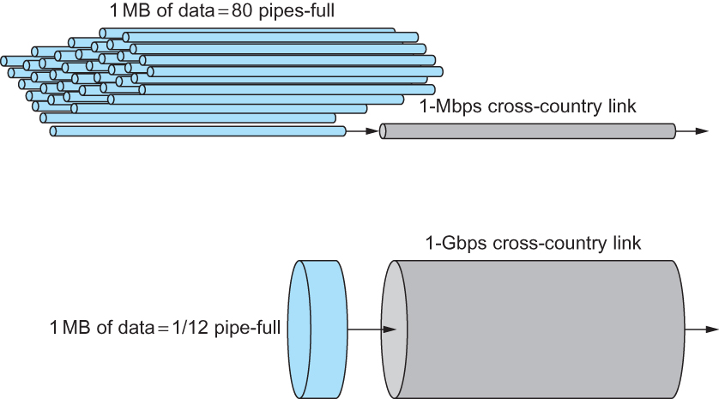
Performance
Relationship between bandwidth and latency
A 1-MB file would fill the 1-Mbps link 80 times,
but only fill the 1-Gbps link 1/12 of one time

Slide 15
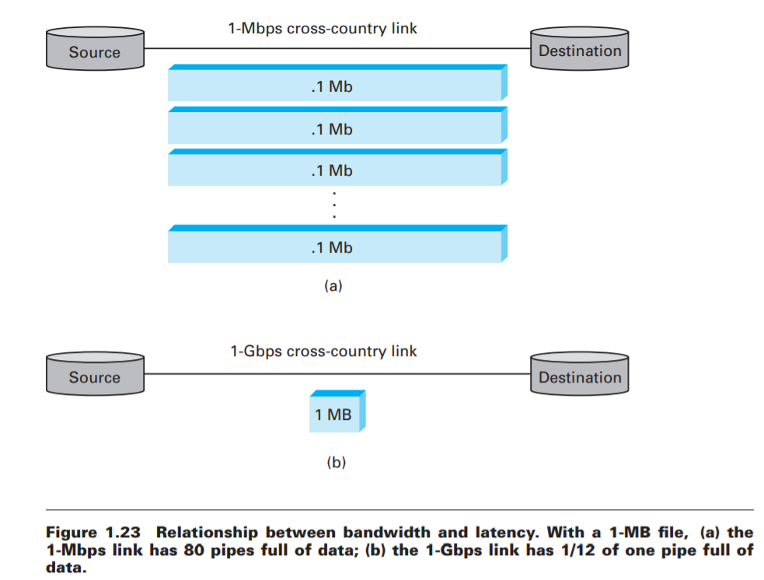
Performance
Relationship between bandwidth and latency

Slide 16
Performance
If we have Infinite bandwidth then
RTT dominates
Throughput = TransferSize / TransferTime
Here transfer time includes all other types of delay such as requesting or setting up for transfer.
So, in general
TransferTime = RTT + 1/Bandwidth x TransferSize
RTT: Assuming client request for file and then receives the file.

Slide 17
Performance
Assume client requests for 1MB file across 1Gbps network with a round trip time 100ms.
Transfer Time = RTT + 1/Bandwidth x TransferSize
Transfer time = 100ms+1MB /1Gbps = 108 ms
Throughput=1MB/108ms = 74.1 Mbps
Bandwidth is 1 Gbps but throughput is 74.1 Mbps
Larger amount of transfer size improves throughput
RTT for each retransmission of missing packet effect the effective throughput.

Slide 18
Performance
Application Performance Needs:
Video streaming applications.
352 x 240 pixels x 24bit color = 247.5 KB
If 30 frames per second is the requirement of application then
247.5 x 2^10 x 8 x 30 =75Mbps Throughput is required.
Even if network bandwidth is more, the application needs only 75 Mbps.

Slide 19
Performance
Application Performance Needs
Jitter effects the performance.
Burst data and congestion in network affects the performance of the application

Slide 20
Problems
1. Calculate the total time required to transfer a 1000-KB file in the following cases, assuming an RTT of 50 ms, a packet size of 1 KB data, and an initial 2×RTT of “handshaking” before data is sent:
The bandwidth is 1.5 Mbps, and data packets can be sent continuously.
The bandwidth is 1.5 Mbps, but after we finish sending each data packet we must wait one RTT before sending the next.
The bandwidth is “infinite,” meaning that we take transmit time to be zero, and up to 20 packets can be sent per RTT.
The bandwidth is infinite, and during the first RTT we can send one packet (2¹⁻¹), during the second RTT we can send two packets (2²⁻¹), during the third we can send four (2³⁻¹), and so on.

Slide 21
Excersise Problems
1. Calculate the total time required to transfer a 1000-KB file in the following cases, assuming an RTT of 50 ms, a packet size of 1 KB data, and an initial 2×RTT of “handshaking” before data is sent:
The bandwidth is 1.5 Mbps, and data packets can be sent continuously.

Slide 22
Excersise Problems
1. Calculate the total time required to transfer a 1000-KB file in the following cases, assuming an RTT of 50 ms, a packet size of 1 KB data, and an initial 2×RTT of “handshaking” before data is sent:
The bandwidth is 1.5 Mbps, and data packets can be sent continuously.
Given : Total size of Data: 1000 KB
Packet Size= 1 KB
Bandwidth = 1.5 Mbps
Latency=Propagation+Tranmit

Slide 23
Excersise Problems
1. Calculate the total time required to transfer a 1000-KB file in the following cases, assuming an RTT of 50 ms, a packet size of 1 KB data, and an initial 2×RTT of “handshaking” before data is sent:
The bandwidth is 1.5 Mbps, and data packets can be sent continuously.
Given : Total size of Data: 1000 KB
Packet Size= 1 KB
Bandwidth = 1.5 Mbps
Latency =2RTT+ Propagation + Transmit + Queue
Propagation = RTT/2 = 25ms
Transmit= 1000 KB/1.5Mbps =1000 x 2¹⁰ x 8 / 1.5 x 10⁶ =5.4613
Latency= 100ms+25ms+5.4613 sec=5.5863 sec

Slide 24
Problems
1. Calculate the total time required to transfer a 1000-KB file in the following cases, assuming an RTT of 50 ms, a packet size of 1 KB data, and an initial 2×RTT of “handshaking” before data is sent:
The bandwidth is 1.5 Mbps, and data packets can be sent continuously.
The bandwidth is 1.5 Mbps, but after we finish sending each data packet we must wait one RTT before sending the next.
The bandwidth is “infinite,” meaning that we take transmit time to be zero, and up to 20 packets can be sent per RTT.
The bandwidth is infinite, and during the first RTT we can send one packet (2¹⁻¹), during the second RTT we can send two packets (2²⁻¹), during the third we can send four (2³⁻¹), and so on.

Slide 25
Problems
Calculate the total time required to transfer a 1000-KB file in the following cases, assuming an RTT of 50 ms, a packet size of 1 KB data, and an initial 2×RTT of “handshaking” before data is sent:
The bandwidth is 1.5 Mbps, but after we finish sending each data packet we must wait one RTT before sending the next.
Given : Total size of Data: 1000 KB
Packet Size= 1 KB
Bandwidth = 1.5 Mbps
Latency =2RTT+ Propagation + Transmit + Queue
Propagation = RTT/2 = 25ms
Transmit= 1000 KB/1.5Mbps =1000 x 2¹⁰ x 8 / 1.5 x 10⁶ =5.4613
Latency= 100ms+25ms+5.4613 sec +999 x 50ms=5.4613+49.95 = 55.4113

Slide 26
Problems
1. Calculate the total time required to transfer a 1000-KB file in the following cases, assuming an RTT of 50 ms, a packet size of 1 KB data, and an initial 2×RTT of “handshaking” before data is sent:
The bandwidth is 1.5 Mbps, and data packets can be sent continuously.
The bandwidth is 1.5 Mbps, but after we finish sending each data packet we must wait one RTT before sending the next.
The bandwidth is “infinite,” meaning that we take transmit time to be zero, and up to 20 packets can be sent per RTT.
The bandwidth is infinite, and during the first RTT we can send one packet (2¹⁻¹), during the second RTT we can send two packets (2²⁻¹), during the third we can send four (2³⁻¹), and so on.

Slide 27
Problems
1. Calculate the total time required to transfer a 1000-KB file in the following cases, assuming an RTT of 50 ms, a packet size of 1 KB data, and an initial 2×RTT of “handshaking” before data is sent:
The bandwidth is 1.5 Mbps, and data packets can be sent continuously.
The bandwidth is 1.5 Mbps, but after we finish sending each data packet we must wait one RTT before sending the next.
The bandwidth is “infinite,” meaning that we take transmit time to be zero, and up to 20 packets can be sent per RTT.
The bandwidth is infinite, and during the first RTT we can send one packet (2¹⁻¹), during the second RTT we can send two packets (2²⁻¹), during the third we can send four (2³⁻¹), and so on.

Slide 28
Problems
2. Calculate the total time required to transfer a 1.5 MB file in the following cases, assuming an RTT of 80 ms, a packet size of 1KB data, and an initial 2 x RTT of “handshaking” before data is sent:
The bandwidth is 10 Mbps, and data packets can be sent continuously.
The bandwidth is 10 Mbps, but after we finish sending each data packet we must wait one RTT before sending the next.
The link allows infinitely fast transmit, but limits bandwidth such that only 20 packets can be sent per RTT
Zero transmit time as in (c), but during the first RTT we can send one packet, during the second RTT we can send two packets, during the third we can send four (2³⁻¹), etc.

Slide 29

Reference
Computer Networks: A Systems Approach, 5Th Edition by PETERSON LARRY L. ET.AL (Author)

